Slide 1

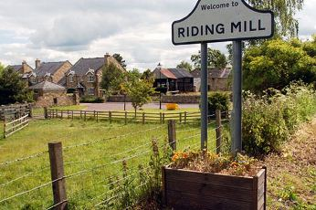
A Neighbourhood Plan for Broomhaugh and Riding
Peter Rutherford, Northumberland County Council

Slide 2
So what are the coalition government’s objectives for Neighbourhood Planning?
They are to:
Empower local communities;
Be neighbourhood focused and led (through Town and Parish councils);
Involve a light-touch process;
Inspire innovation and creativity;
Enable community development;
Create a permissive regime; and
Incentivise communities to support growth.

Slide 3
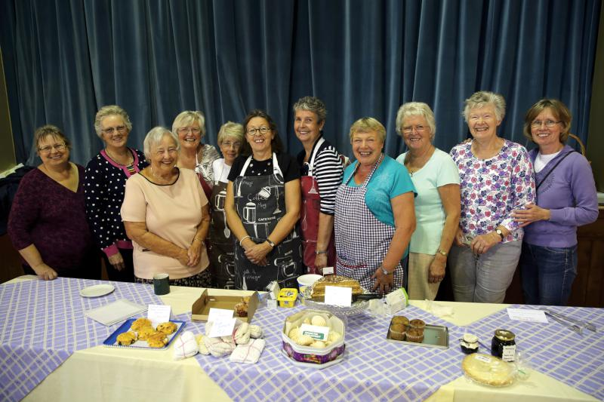

And to:
Give power to local people through their Town or Parish Council to produce their own plan;
Provide for discretionary plan making at the local level;
Represent community-led plans with ‘teeth’ - real power to manage development: on adoption, planning applications must be decided in line with their policies; and
Address local rather than strategic issues.

Slide 4
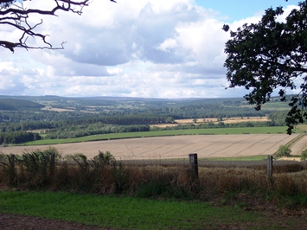
Who can produce a Neighbourhood Plan?
A Qualifying Body – a Town or Parish Council;
Parishes may combine to produce a joint plan, but one council must be designated as the lead (qualifying body);
The Local Authority has a duty to support neighbourhood planning;
Tested by independent examination – checks that consultation has been done and ‘basic conditions’ have been met; and
The Local Planning Authority ‘makes’ the plan if it is supported in a local referendum

Slide 5
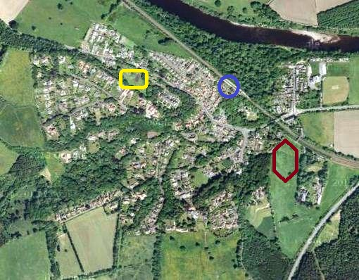
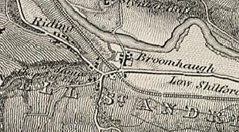
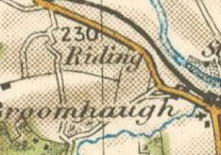
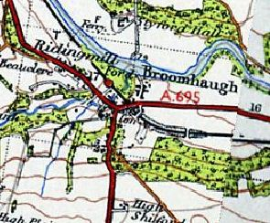
What can Neighbourhood Plans do?
They can set out:
A local spatial vision; what should go where;
Locally devised land-use policies to guide and manage development in the plan area, and
Allocate land for development.

Slide 6
Are they restricted in their ambitions?
Neighbourhood plans can cover any matter important to the local community;
Neighbourhood Plans are specifically about planning policy;
Policies in the Plan can be used to make planning decisions;
Plans cannot prevent development already agreed through higher level plans (Core Strategy/Local Plan) – which promote sustainable development/growth;
Cannot deal with strategic planning matters – i.e. major infrastructure and minerals and waste matters; and finally
Only one plan for each neighbourhood area and it must last for a reasonable period of time, say 15 years.

Slide 7
What they must do.
Neighbourhood Plans must meet a set of basic conditions prescribed in legislation before they can be approved, they must;
Be prepared having regard to national policy and guidance;
Conform with the strategic policies set out in the statutory Development Plan for the area;
Contribute to the achievement of sustainable development; and
Be compatible with European environmental legislation and Human Rights requirements.
Basic conditions are checked by independent examination. If met and agreed, the Plan can be put to local referendum.

Slide 8
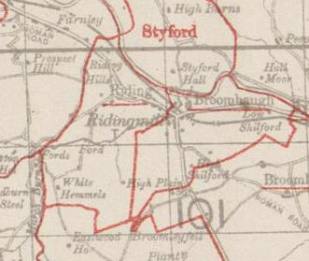
At the outset.
The Plan (Neighbourhood) area is defined by application from the Parish Council (the qualifying body) to the County Council.
The application must include:
A plan or statement identifying proposed neighbourhood area;
A statement why the area is appropriate for neighbourhood planning; and
A statement that the application is submitted by a qualifying body
County Council publicises the application for 4 weeks and invites comments.

Slide 9
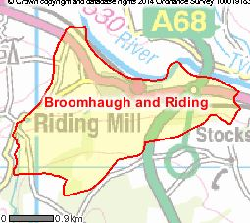
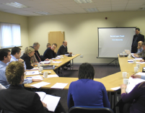
One further matter.
The resources available to prepare the plan – is external professional support needed?

Slide 10
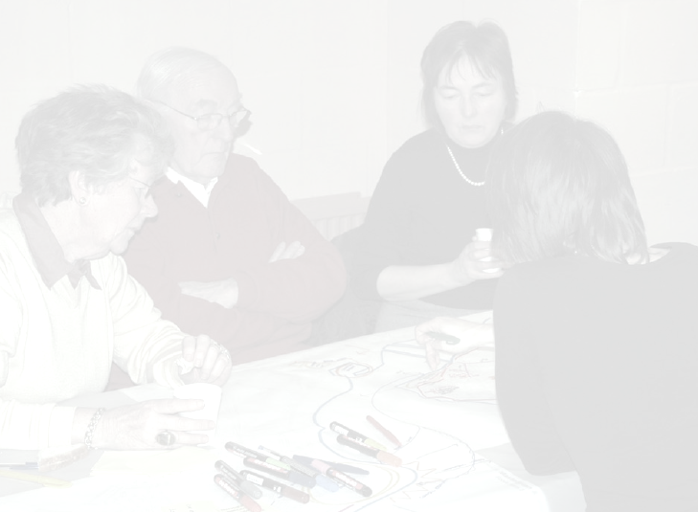
The Plan should:
Be neighbourhood focused and led;
Address local rather than strategic issues;
Inspire innovation and creativity;
Create a permissive regime;
Incentivise communities to support growth, and
Represent community-led plans with ‘teeth’ – real power to manage development.
Questions for Broomhaugh and Riding
Whole Parish or small area?
What local issues should the plan address?
Thematic?
What’s the philosophy?
Comfortable with this?
Carrying the community?

Slide 11
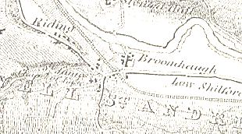
Neighbourhood Plan
Whole Parish
Thematic
Area based
Outcome led

Slide 12
Neighbourhood Plan
Whole Parish
Thematic
Area based
Outcome led

Slide 13
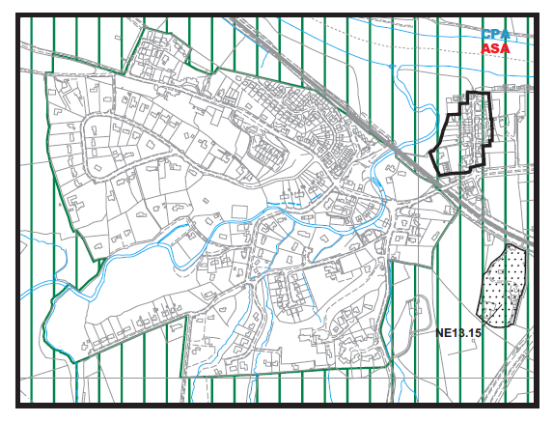
Whole Parish
Northumberland Local Plan
Core Strategy - Full draft plan: December 2014
Across the Central Northumberland Delivery Area out with the Main Towns and Service Centres Plan proposes 1,120 new homes, (average number 56 p.a.) over the plan period (2011 to 2031): Relationship with Northumberland Local Plan Delivery Document.

Slide 14
Neighbourhood Plan
Whole Parish
Thematic
Area based
Outcome led

Slide 15
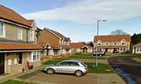
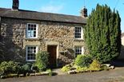

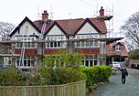



Thematic
Affordable housing
Built environment
Design
Economy and commerce
Natural environment
Renewables
Sustainable construction

Slide 16
Neighbourhood Plan
Whole Parish
Thematic
Area based
Outcome led

Slide 17
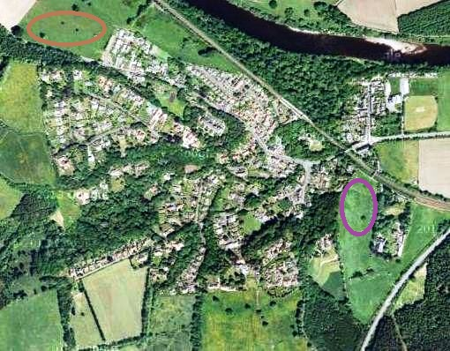
Area based:
Employment land, or
Expansion

Slide 18
Neighbourhood Plan
Whole Parish
Thematic
Area based
Outcome led

Slide 19
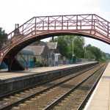
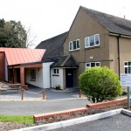
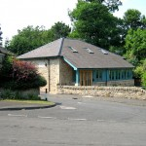
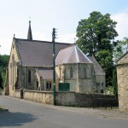
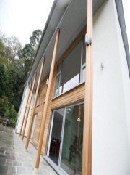
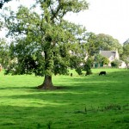
Outcome led.
Core Strategy's proposed sustainable growth calculated to create around £64 million GVA;
Creating additional revenues, wealth and more disposable income;
Potential for further investment in built fabric and public realm by public sector with private sector match?
Plan provides vision, objectives, strategy and policy framework to protect, sustain and enhance built fabric (and natural environment);
Improved design, and
Better quality buildings and spaces;

Slide 20
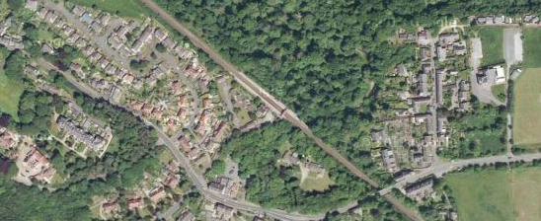
In any event.
The Parish Council:
Prepares and publicises draft plan – bringing it to the attention of those who live, work or operate business in neighbourhood area;
Publishes contact details for submission of representations and information about timetable for consultation (minimum 6 week consultation period);
Consults statutory consultees whose interests may be affected by the plan;
Considers representations and may amend draft plan; whereupon
Further consultation is optional.

Slide 21
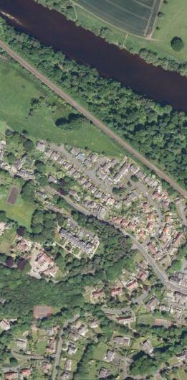
And then?
Parish Council submits plan to County Council with:
Plan or statement showing or describing plan area;
Consultation statement;
Title of draft plan; and
Statement on how plan meets basic conditions.
The consultation statement must:
Identify who was consulted by parish council;
Describe how they were consulted;
Provide summary of main issues raised; and
Describe how issues have been addressed.
County Council publicises the plan for a minimum of 6 weeks and describes how people can make representations.

Slide 22
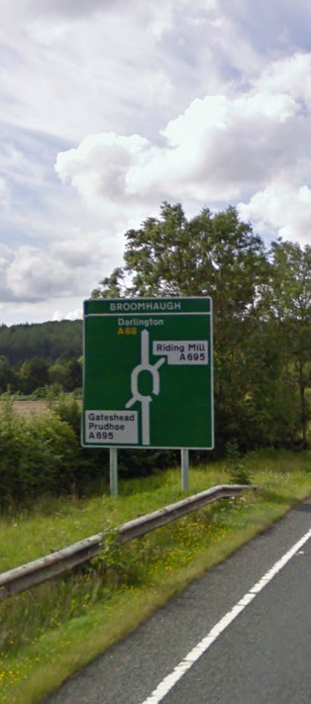
Referendum
County Council;
Publishes examiners report;
Publishes decision to put plan to referendum;
Arranges and funds referendum;
Following successful referendum publishes decision to ‘make’ plan (with reasons);
Advises Parish Council and consultees of decision; and
Publishes plan – it now becomes part of the Development Plan and material to the determination of planning applications.

Slide 23
Concluding questions.
What should be the:
Extent of the plan area?
Resources available to prepare the plan – is external professional support needed?
Extent of growth to be planned and evidence available: housing; employment; retail; other?
Plan period: needs to last for a reasonable timeframe – 15 years or Core Strategy plan period?
Governance arrangements

Slide 24
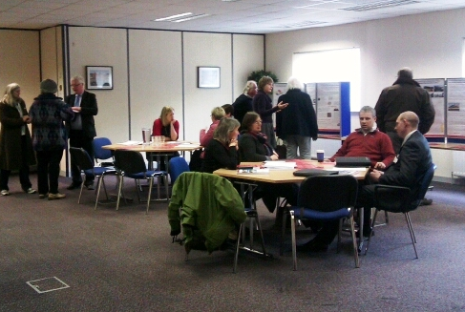
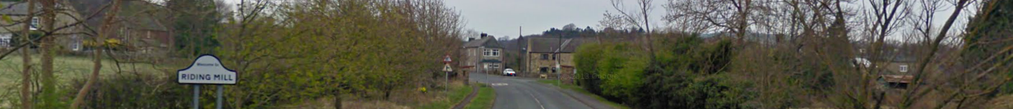
What will be needed?
Time;
People;
Skills;
Money;
Energy; and
A good, clear reason to start.

Slide 25
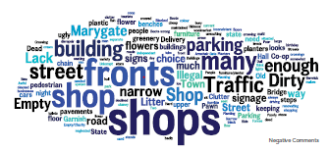
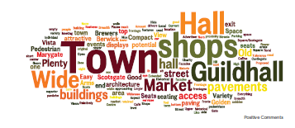
Some lessons from elsewhere.
Know why you want a plan before starting;
Get agreement early in the process on who is leading and who can make decisions – stay flexible, but focused; foster trust and respect; remain tenacious;
Establish who will prepare the plan before starting – people with time and energy are invaluable; and
Keep it simple, proportionate and relevant.

